Slide 1
Bayesian Modelling Workshop
3rd Session – Incorporating Prior Knowledge
April 13th, 2023

Slide 2
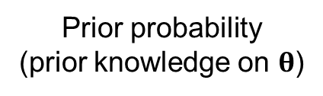
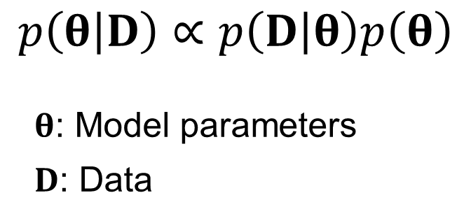
Bayesian Modelling
Data likelihood
Prior probability
(prior knowledge on $θ$)
$$p\left(θ | D\right)∝p\left(D | θ\right)p\left(θ\right)$$
$θ$: Model parameters
$D$: Data
Posterior probability
(Not a point estimation)

Slide 3
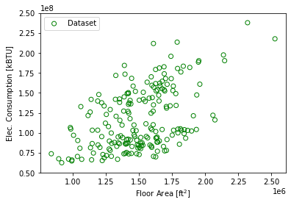
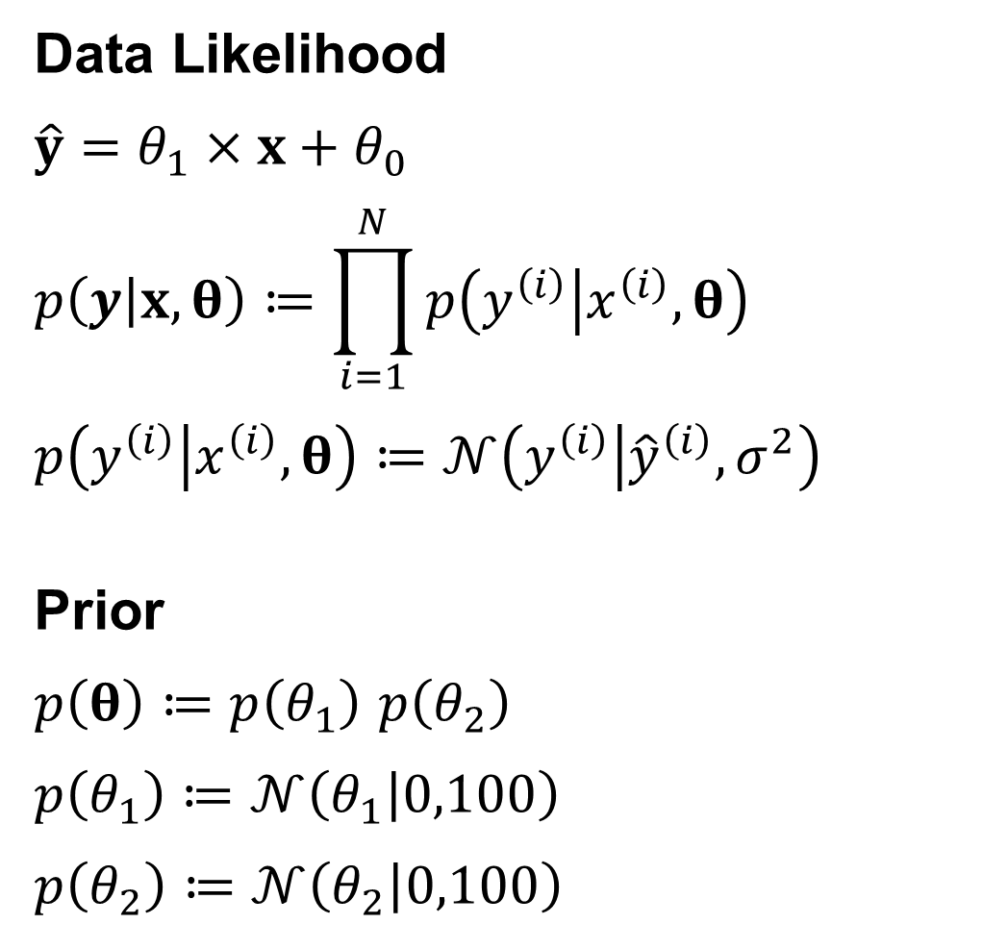
Bayesian Linear Regression
Data Likelihood
$$\hat{y}=θ_{1}×x+θ_{0}$$
$$p\left(y | x,θ\right)≔\prod_{i=1}^{N}{p\left(y^{\left(i\right)} | x^{\left(i\right)},θ\right)}$$
$$p\left(y^{\left(i\right)} | x^{\left(i\right)},θ\right)≔𝒩\left(y^{\left(i\right)} | {\hat{y}}^{\left(i\right)},σ^{2}\right)$$
Prior
$p\left(θ\right)≔p\left(θ_{1}\right)$ $p\left(θ_{2}\right)$
$$p\left(θ_{1}\right)≔𝒩\left(θ_{1} | 0,100\right)$$
$$p\left(θ_{2}\right)≔𝒩\left(θ_{2} | 0,100\right)$$

Slide 4
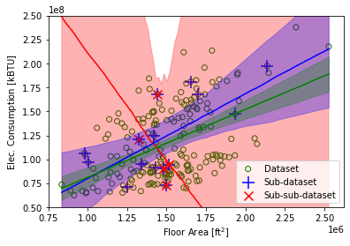
Bayesian Linear Regression
Bayesian with non-informative prior

Slide 5
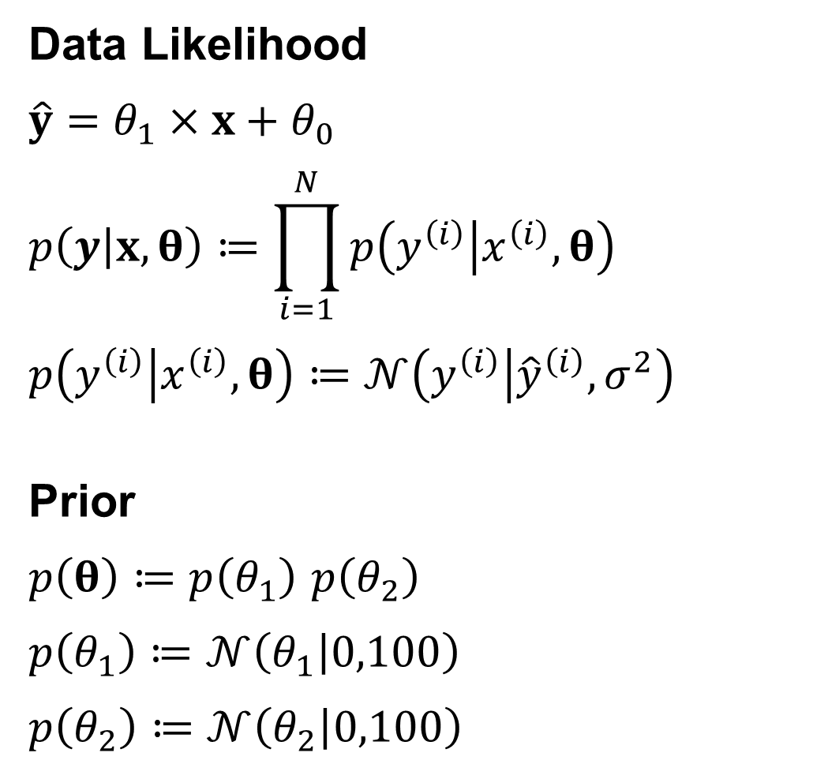
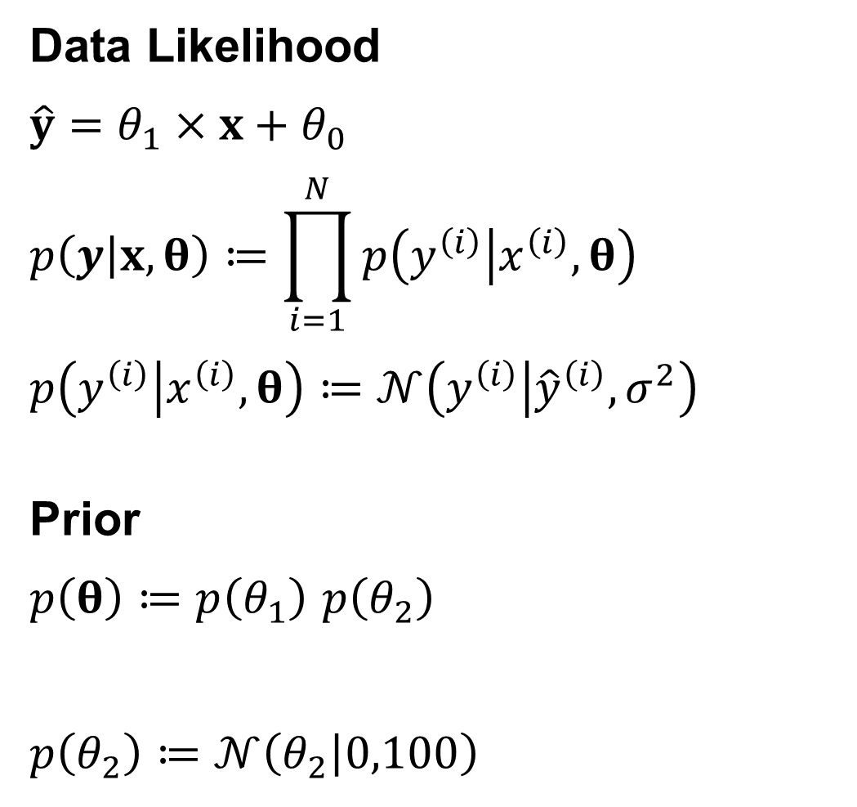
Bayesian Linear Regression with Positive Slope
Data Likelihood
$$\hat{y}=θ_{1}×x+θ_{0}$$
$$p\left(y | x,θ\right)≔\prod_{i=1}^{N}{p\left(y^{\left(i\right)} | x^{\left(i\right)},θ\right)}$$
$$p\left(y^{\left(i\right)} | x^{\left(i\right)},θ\right)≔𝒩\left(y^{\left(i\right)} | {\hat{y}}^{\left(i\right)},σ^{2}\right)$$
Prior
$p\left(θ\right)≔p\left(θ_{1}\right)$ $p\left(θ_{2}\right)$
$$p\left(θ_{1}\right)≔𝒩\left(θ_{1} | 0,100\right)$$
$$p\left(θ_{2}\right)≔𝒩\left(θ_{2} | 0,100\right)$$
Data Likelihood
$$\hat{y}=θ_{1}×x+θ_{0}$$
$$p\left(y | x,θ\right)≔\prod_{i=1}^{N}{p\left(y^{\left(i\right)} | x^{\left(i\right)},θ\right)}$$
$$p\left(y^{\left(i\right)} | x^{\left(i\right)},θ\right)≔𝒩\left(y^{\left(i\right)} | {\hat{y}}^{\left(i\right)},σ^{2}\right)$$
Prior
$p\left(θ\right)≔p\left(θ_{1}\right)$ $p\left(θ_{2}\right)$
$$p\left(θ_{2}\right)≔𝒩\left(θ_{2} | 0,100\right)$$
Notes:
$$p\left(θ_{1}\right)≔Exp\left(θ_{1} | λ=0.1\right)$$

Slide 6
Bayesian Linear Regression with Positive Slope
$$p\left(θ_{1}\right)≔𝒩\left(θ_{1} | 0,σ^{2}\right)$$
$$p\left(θ_{1}\right)≔Exp\left(θ_{1} | λ\right)$$

Slide 7
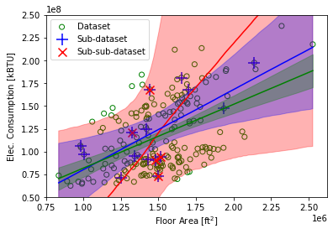
Bayesian Linear Regression with Positive Slope
Bayesian
With non-informative prior
Bayesian
with informative prior (positive slope)

Slide 8
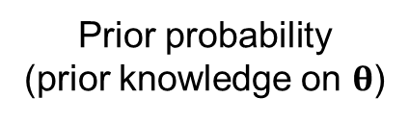
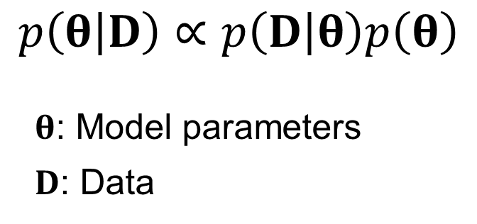
Bayesian Modelling
Data likelihood
Prior probability
(prior knowledge on $θ$)
$$p\left(θ | D\right)∝p\left(D | θ\right)p\left(θ\right)$$
$θ$: Model parameters
$D$: Data
Posterior probability
(Not a point estimation)
Incorporate your knowledge and/or information from the literature
Deal with missing data/information → 4th Session
Prior probability over functions! → 5th Session

Slide 9
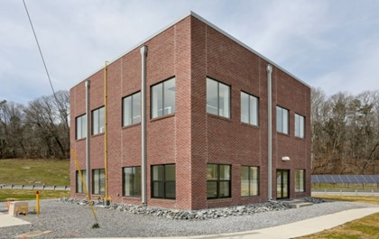
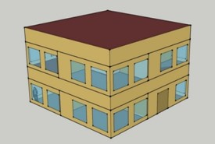
Bayesian Material Property Calibration/Estimation
Create datasets from the FRP for empirical validation of simulation tools, which has limited input uncertainty compared to real buildings.
Provide modeling Input document + operational data
Demonstrate with a detailed EnergyPlus model

Slide 10
Bayesian Material Property Calibration/Estimation
Temperature
Heat flux
Interior
Exterior
Gypsum
Batt Ins.
Concrete block
Air gap
Brick

Slide 11


Bayesian Estimation with 1-D Finite Difference Heat Conduction Model
Internal node heat diffusion equation
$$C_{p,i}ρ_{i}Δx\frac{dT_{i}}{dt}=\frac{k_{i}}{Δx}\left(T_{i+1}−2T_{i}+T_{i−1}\right)$$
discretization
Node temperatures
Boundary conditions
20 nodes (3 in gypsum, 6 in insulation, 10 in concrete block, 6 in face brick)
$x_{k+1}=A_{d}x_{k}+B_{d}u_{k}+w_{k}$
$y_{k}=C_{d}x_{k}+v_{k}$
$w_{k}\sim 𝒩\left(0,Q\right)$
$v_{k}\sim 𝒩\left(0,R\right)$
Process noise
Unconsidered factors influencing the dynamic
Model imperfection
Measurement noise

Slide 12
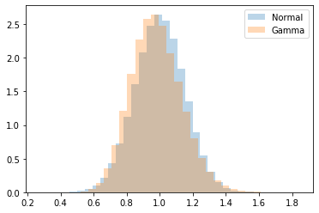
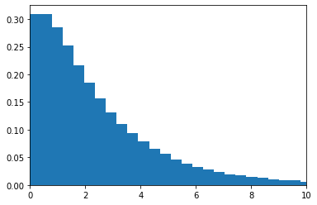
Bayesian Estimation with 1-D Finite Difference Heat Conduction Model
Prior distributions for the other material properties (Gamma)
mean: ~EP input values
95% interval: ~±30% of mean
Prior distribution for the density of the batt insulation layer (Gamma)
Very flat hierarchical
mean
~±30% of mean
Prior distribution for the density of the batt insulation layer (1/1000)

Slide 13
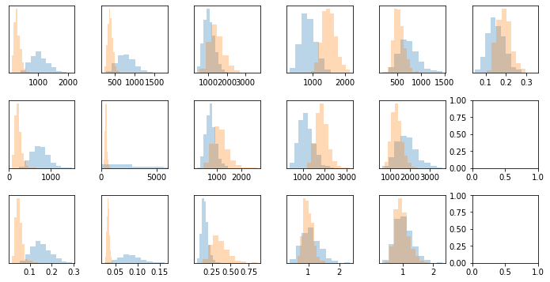
Bayesian Estimation with 1-D Finite Difference Heat Conduction Model
Gypsum
Batt
Gypsum
CMU
Face Brick
Cp
[J/kg-K]
Air R
[m2-K/W]
ρ
[kg/m3]
k
[W/m-K]
R-value computed with median values = 3.625 [m2-K/W]

Slide 14
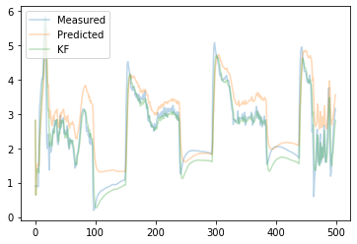
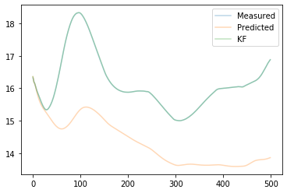
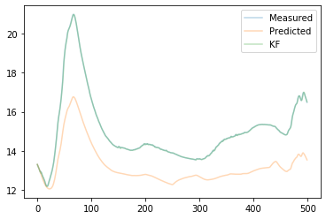
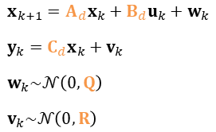
Bayesian Estimation with 1-D Finite Difference Heat Conduction Model
Node temperatures
Boundary conditions
1
2
3
$x_{k+1}=A_{d}x_{k}+B_{d}u_{k}+w_{k}$
$y_{k}=C_{d}x_{k}+v_{k}$
$w_{k}\sim 𝒩\left(0,Q\right)$
$v_{k}\sim 𝒩\left(0,R\right)$
Process noise
Unconsidered factors influencing the dynamic
Model imperfection
Measurement noise
1
2
3
Median values of the root of the diagonal components in the process noise covariance matrix: 0.00189 – 0.413
Median values of the root of the diagonal components in the Measurement noise covariance matrix: 0.408, 0.00712, 0.0124

Slide 15







GRID-INTERACTIVE CONTROL
ENERGY SYSTEM
OPTIMAL CONTROL
ENERGY & DATA
MANAGEMENT
FAULT DETECTION AND DIAGNOSIS
HUMAN-BUILDING INTERACTION
Thank you!
(sjae.lee@utoronto.ca)

